Slide 1

Welcome to
Chester County Cloud, Data & AI/ML Group
(3CDAIML)
meetup.com/3CDAIML
github.com/3CDAIML
Linkedin.com/8837487

Slide 2
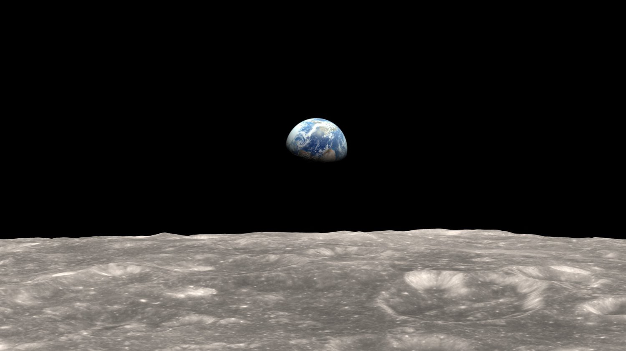

Kumar Sista
Cloud Solution Architect, Microsoft
LinkedIn: kumarsista
November 13, 2019
Session 1
Artificial Intelligence
This Photo by Unknown Author is licensed under CC BY-NC

Slide 3
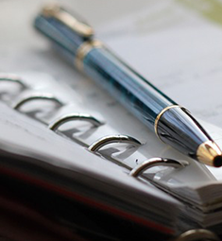
Agenda for today…
What is AI…
Technologies of AI
Primary questions & fears…
Responsible Principals & Ethics…
Future can be…
GET INVOLVED

Slide 4
What is AI?
Intelligence: The ability to acquire and apply knowledge and skills. https://www.bing.com/search?q=intelligence&PC=U531&cvid=5f91a83f70384af3a5d19571850c71c0&FORM=ANAB01
Artificial Intelligence: The theory and development of computer systems able to perform tasks that normally require human intelligence, such as visual perception, speech recognition, decision-making, and translation between languages.
https://www.bing.com/search?q=artificial%20intelligence&qs=n&form=QBRE&sp=-1&pq=artificial%20intelligence&sc=6-23&sk=&cvid=6B143A5636D144C588F5E9F9DC0FA949

Slide 5
AI compared to Human
Human | Computer
Vision | Computer Vision
Hearing & Speech | Speech recognition / Voice recognition
Read, Understand & Write | Natural Language Processing (NLP) & Natural Language Generation (NLG)
Touch & Motion | Kinematics and Robotics
Thinking, Reasoning, Decision Making based on inputs and experience, Learning, Extract information from data, Cognitive Functions | General AI – just starting
Smell | Nothing still, may be possible
Emotion | Nothing still, is it really possible?

Slide 6
Technologies of AI
Machine Learning & Deep Learning & Artificial Neural Networks (ANN)
Knowledge Mining – Cognitive Search
Cognitive Services – Vision, Speech, Language & Decision
Bot Services

Slide 7
Types of AI
Weak AI
Strong AI
Super AI
aka Narrow AI
Recommendation Engines
Advanced Driver Assistance Systems (ADAS)
Game playing systems
aka Broad AI
Terminator
Wall-E, Eve and Ship’s computer in Wall-E
Andrew in Bicentennial Man
More intelligent than Humans in all aspects including, creativity, wisdom, problem-solving, etc.

Slide 8
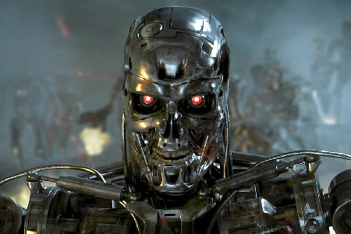
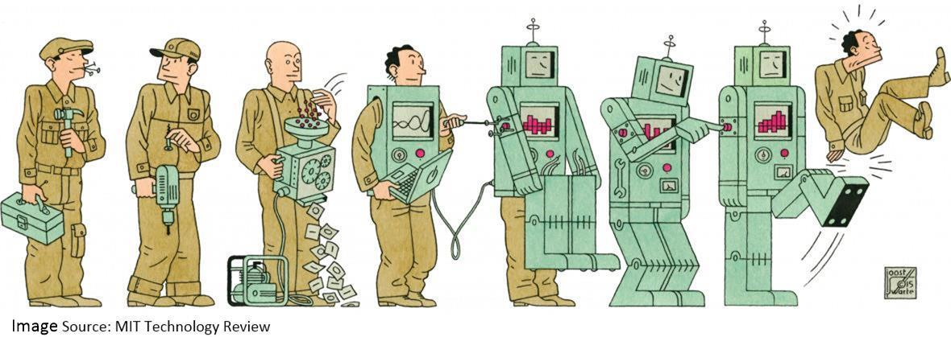
Primary Questions & Fears…
Will AI take over the world?
Will AI eliminate jobs?

Slide 9

Principles, Values & Ethics for AI…

Slide 10
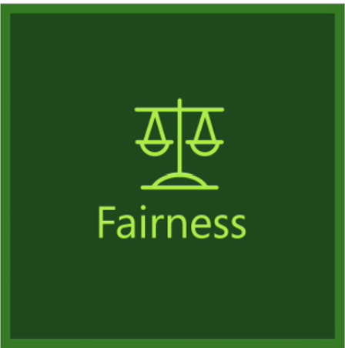





Responsible AI Principles
https://www.microsoft.com/en-us/AI/our-approach-to-ai

Slide 11

Thank You!

Slide 12
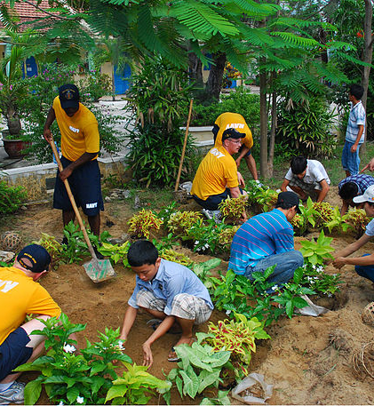
GET INVOLVED…
Come – support speakers – interact – enjoy!
SPEAK!! (We’ll help)
Refer speakers
Co-organize

Slide 13
Thank You!
Contact
Kumar Sista
LinkedIn: kumarsista
Resources
Meetup: meetup.om/3CDAIML
All session materials: github.com/3CDAIML
LinkedIn Group: 3CDAIML

